Slide 1

Simple Todo App
By Brandon Truong
Notes:
Hello and welcome to my presentation! Today I will be presenting my simple todo app, built entirely in java through android studio. I will be covering the core components of the app, what we need to create the logic behind the app, and the steps after. If you have any questions, feel free to ask me either during or after the presentation!

Slide 2
Goals of the app
With this app we want to be able to:
View all added items in the list
Add items into a list
Remove an item by holding on it
Save and load user data
Edit an item by pressing on it
Notes:
For this app, we want to keep the functions simple. We will be adding logic that allows us to *bullet points

Slide 3


Tools used
IDE - Android Studio
Language - Java
VCS - Git
Notes:
For my tools, I used android studio integrated development environment. Android studio is a great workstation that
This IDE is built to support app development
With robust tools such as
previews of layouts, built-in android emulator to run, code completion, etc.
Language used is Java, which is how we build all our functional methods. Other supported language includes Kotlin
VCS is git, which we manage through github,a remote hosting git service.

Slide 4
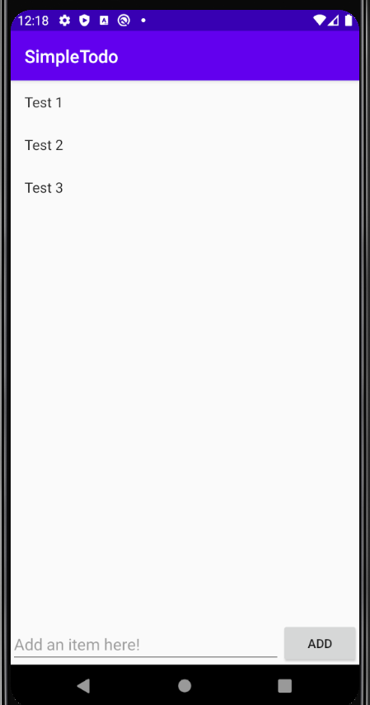
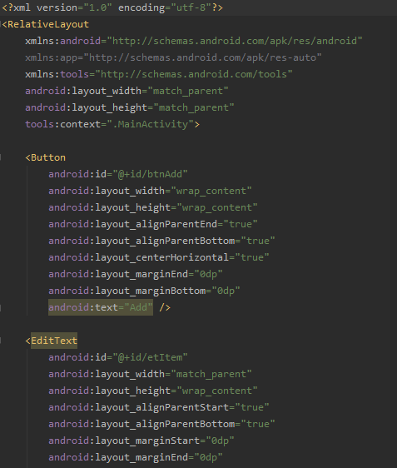
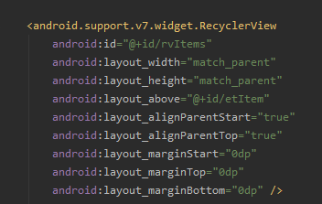
Layouts
Notes:
When we first create our project, we need to set up the main layout that we will be using to view all our items. Android studio makes this easy...
RelativeLayout to allow for child and parent relationships within the layout, responsive
All components are linked to each other in order to have a fluid layout relative to each other - allows for easier resizing based on reso
Xml files that dictate the layout
Recycler View to create the list, uses viewholders to create list objects and the adapter to change
Add button which calls a method when pressed
Plain edit text with a hint

Slide 5
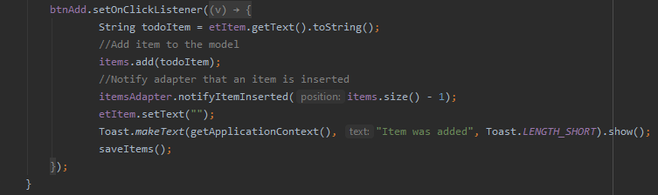
Adding an item
Notes:
The first logic will be to add an item
Utilizing the button, we set a listener to see if it has been clicked
It then takes in the data in the textbox as a string and adds it to the recyclerview adapter
We update all relevant components and uses Toast to show that an item was added

Slide 6
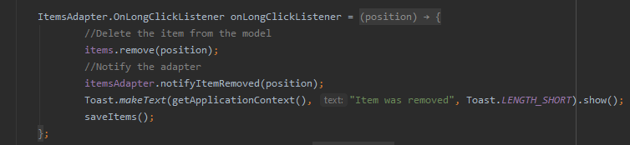
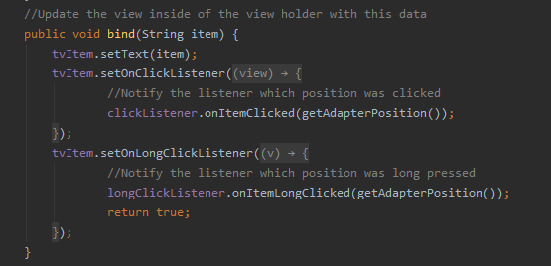
Removing an item
Notes:
We will then pair up the option to add an item with the ability to remove an item
We have an interface called OnLongClickListener which we use alongside the items adapter (recyclerview) to find out which position was held
We then use that data to remove the data in that position and notify the adapter that an item was removed
Toast gives us a notification that an item was removed and all changes are saved.

Slide 7
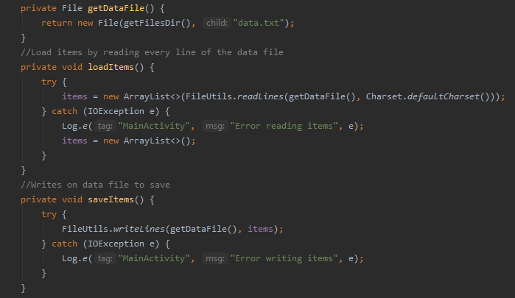
Saving and Loading Data
Notes:
We also want our data to persist even if we exit the app. This persistence will be done by FileUtils
Apache commons fileutils - FileUtils imported class
Three methods to save and load, getDataFile() to find data file, load reads the lines from the data file and outputs an error if it fails, save writes new data into the file and errors out if it fails. Both called within the MainActivity when items are changed.

Slide 8
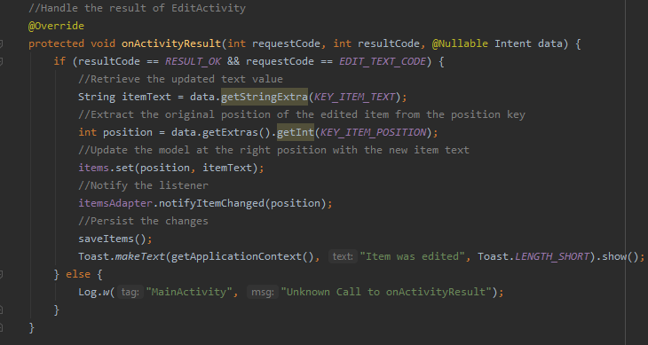
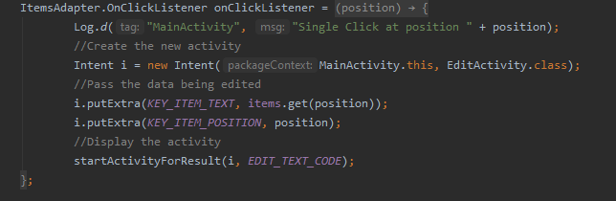
Editing an item
Notes:
Our optional step is to edit an item.
New Activity (EditActivity)
Intents used to manage data and change activities. Like glue that connects activities together and allows us to pipe data
We pass through the position of the item and the text and save all changes in the adapter.

Slide 9
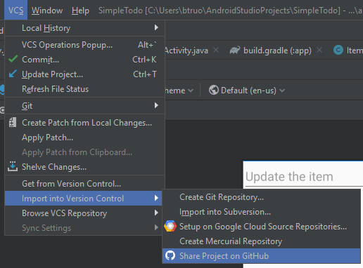
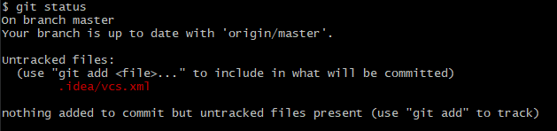
Uploading through Github
Notes:
Now that we have implemented all the functionality, we can then upload and share it through a vcs.
Our VCS is git
Android studio has built in VCS through github
We can create a public repos
Changes made can be committed by git add <file> and git commit
We can use git restore--staged to remove files from the stage
Changes can be managed from local and remote by git pull and git push

Slide 10
Summary
RelativeLayouts through xml
Adding items through buttons and adapter
Removing items through long click listening
Editing Items through Intents and a new Activity
Saving and Loading through FileUtils
Version Control through Git
Notes:
And that’s all we need to know in order to build our app! Let’s have a quick recap of everything:

